Slide 1
Additional Slides and Dimensionality Reduction
AQM - 2019

Slide 2
But first… on selecting optimal k
The most important hyper parameters in many clustering algorithms is the number of expected clusters to look for
Chicken or egg problem: how do we know how many clusters there are in advance?
Have a minimum of k=1 and max k=number of individual data samples
A good heuristic for determining an optimal k is to minimize within variability and at the same time maximize between cluster variability (a min-max problem).

Slide 3
Optimal k
Need a way to extract cluster centroids or representative samples and calculate distance metrics between other elements (sometime the calculation can be slow, eg. Word mover’s distance)
Elbow method for k-means: https://www.scikit-yb.org/en/latest/api/cluster/elbow.html
Sweep across a range of k-values and compute scores:
Distortion (raw sum of squared distance b/w each point to a cluster centroid)
Silhouette (score of how similar a sample is to its assigned cluster vs others – cohesion vs separation)
Calinski-harabaz (score of cluster dispersion)

Slide 4
Optimal k
Need a way to extract cluster centroids or representative samples and calculate distance metrics between other elements (sometime the calculation can be slow, eg. Word mover’s distance)
Elbow method for k-means: https://www.scikit-yb.org/en/latest/api/cluster/elbow.html
Sweep across a range of k-values and compute scores:
Distortion (raw sum of squared distance b/w each point to a cluster centroid)
Silhouette (score of how similar a sample is to its assigned cluster vs others – cohesion vs separation)
Calinski-harabaz (score of cluster dispersion)

Slide 5
Optimal k
Need a way to extract cluster centroids or representative samples and calculate distance metrics between other elements (sometime the calculation can be slow, eg. Word mover’s distance)
Elbow method for k-means: https://www.scikit-yb.org/en/latest/api/cluster/elbow.html
Sweep across a range of k-values and compute scores:
Distortion (raw sum of squared distance b/w each point to a cluster centroid)
Silhouette (score of how similar a sample is to its assigned cluster vs others – cohesion vs separation)
Calinski-harabaz (score of cluster dispersion)

Slide 6
Optimal k
Typically Silhouette score gives a good representation of optimal k, but is slower than distortion
These methods only work on convex and ‘well-dispersed’ datasets and can fail on datasets where clusters have large overlaps
If you can, visualize the dataset with t-Sne (explained later) and see if there are well dispersed clusters!
Please work through the examples posted in the link on the previous slide.

Slide 7
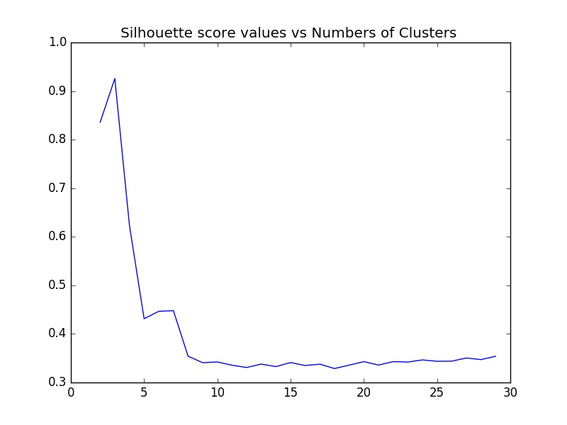
Optimal k

Slide 8
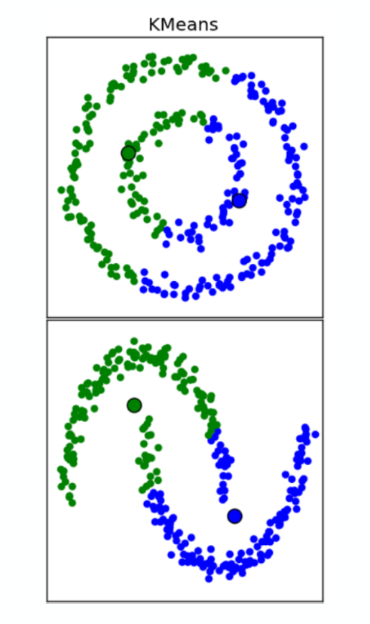
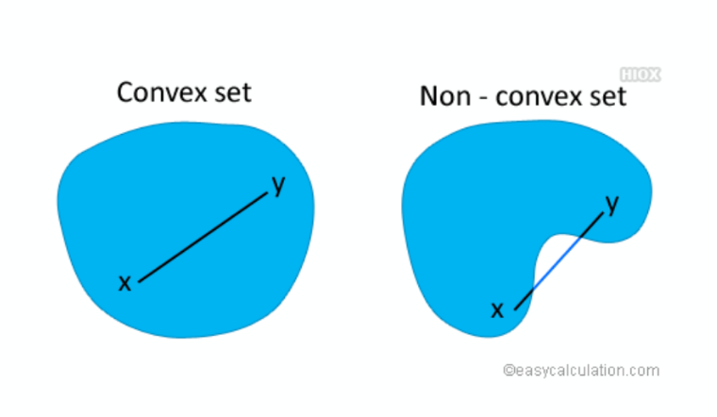
Optimal k

Slide 9
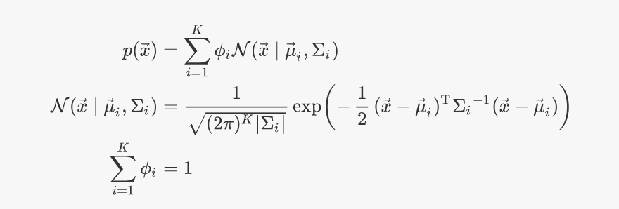
Mixture Models
Clustering can also be done probabilistically. A mixture model assumes a high dimensional probability mixture (not a joint) distribution that has many ‘peaks’ or multimodal, with peaks representing high densities of data point
A Gaussian Mixture Model (GMM) assumes points are generated from a Gaussian mixture distribution p(x)
Still parametric in k

Slide 10
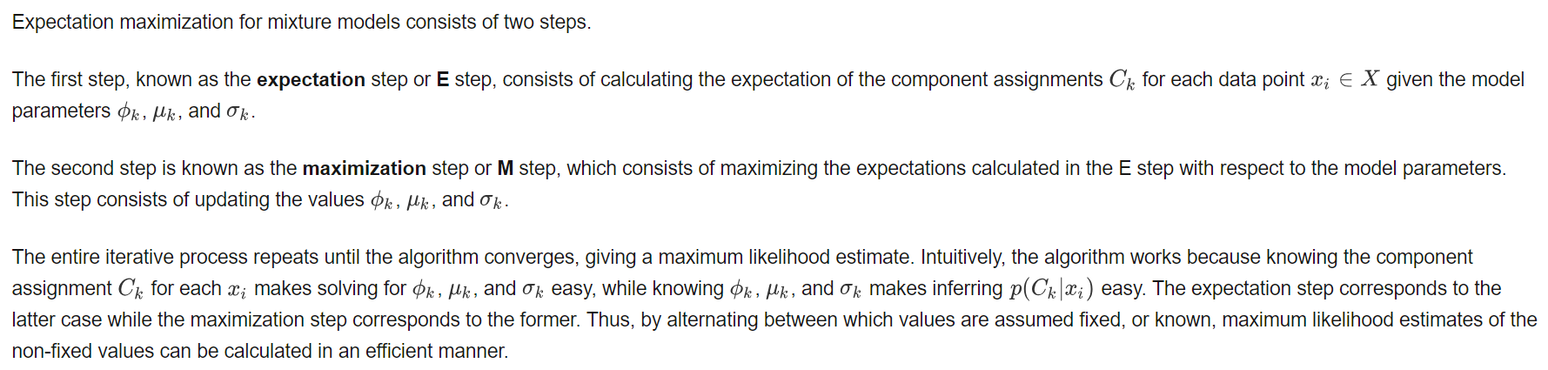
Mixture Models
How do we learn the mixture coefficients/weights?
The expectation-maximization or EM algorithm is guaranteed to final local extrema
https://brilliant.org/wiki/gaussian-mixture-model/

Slide 11
Mixture Models

Slide 12
What is DR?
Dimensionality reduction (DR) is a set of unsupervised techniques to select, extract or transform ‘features’ in the data
Compression (lossy)
Linear Algorithms for Feature selection: LDA, PCA, NMF
Feature transforming, Clustering: Kohonen/Self-organizing map, Neural Gas. Project from high dim feature space to low dim feature space nonlinearly
Visualization: t-SNe, LargeViz
The opposite of DR is high dimensional embedding

Slide 13
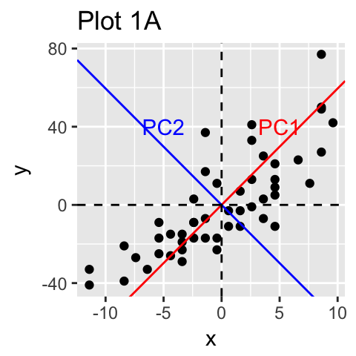
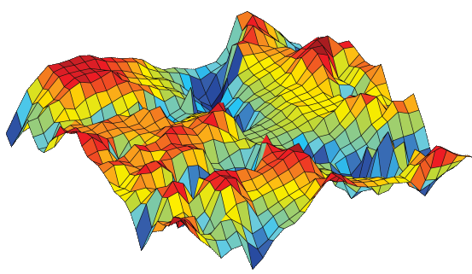
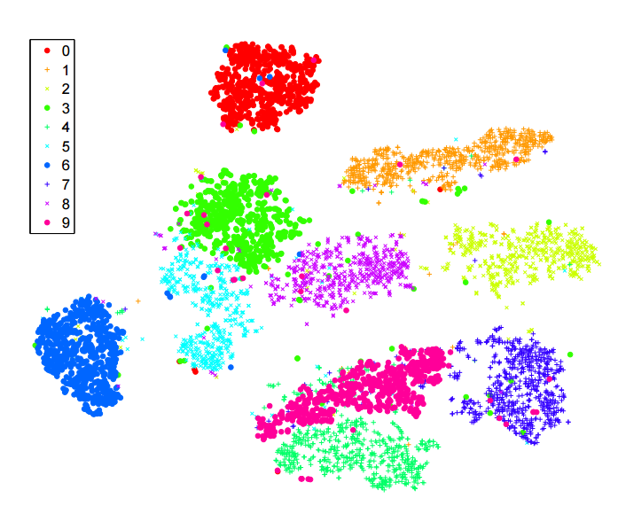
What is DR?

Slide 14
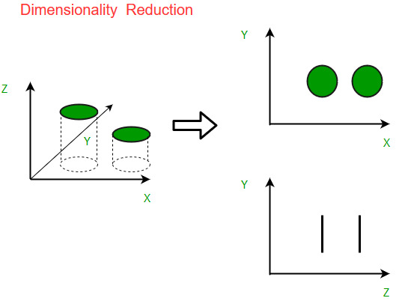
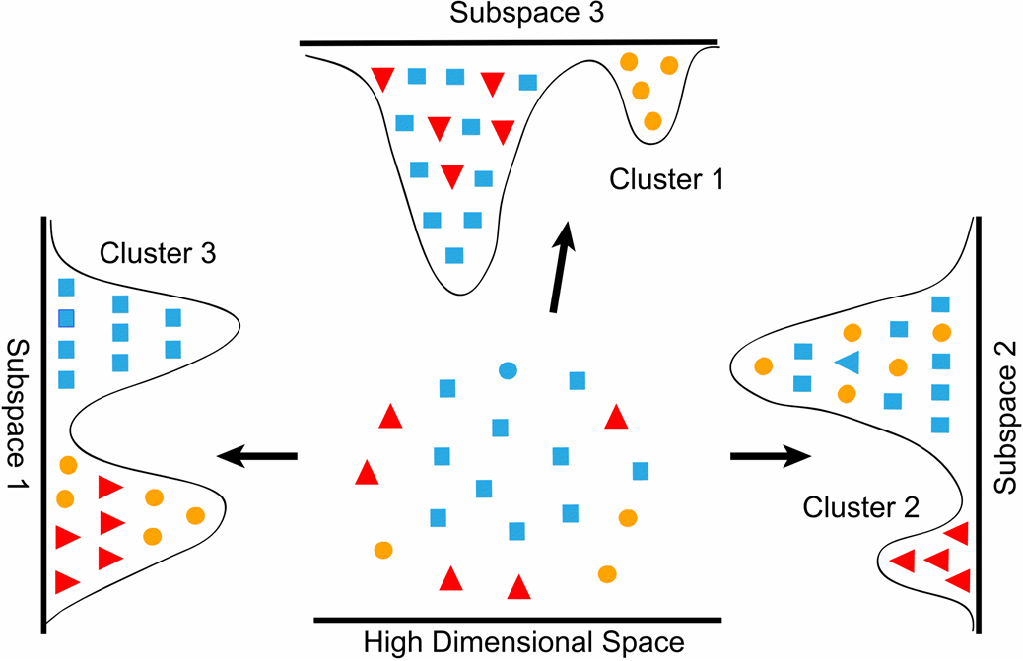
What is DR?

Slide 15
Linear DR
PCA, LDA: Singular value decomposition/eigendecomposition of covariance matrix
Converts a set of possibly correlated (numeric) variables to a set of linearly independent (uncorrelated) vectors (an orthogonal basis in a lower dim)
The largest eigenvalues/eigenvectors ‘explain’ the variance of the dataset proportional to abs(eig_k) / sum(eig_n)
Can be used to determine redundant input variables and variables which are complete noise

Slide 16
Linear DR
PCA in sklearn, see:
https://scikit-learn.org/stable/modules/generated/sklearn.decomposition.PCA.html#sklearn-decomposition-pca
Take home: run PCA on your TransLink numeric input variables. What are the magnitudes of the eigenvalues?

Slide 17
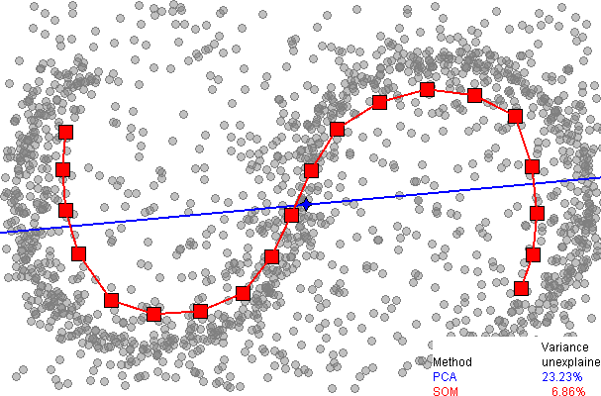
Nonlinear DR
Linear methods are fast and mostly analytic but many times data can have a high dim nonlinear relationship
There is a smooth manifold instead of a hyperplane that ‘fits’ the data

Slide 18
Nonlinear DR
NLDR algorithms are more powerful but also harder to use: computational complexity, lack of convergence guarantee, non-analytic etc.
Useful when there is a suspicion of complicated non-linear relationships in high dim data, as a preliminary exploratory visualization (t-Sne, LargeViz), or as a ‘feeder stage’ to multi-level deep learning models
A survey of NLDR algorithms: https://en.wikipedia.org/wiki/Nonlinear_dimensionality_reduction

Slide 19
Visualization Algorithms
SNe:
Construct a high dimensional distribution P representing a likelihood of picking similar points, which are inversely proportional to some metric of similarity (Gaussian distributed points)
Construct a low dimensional (2D, 3D) distribution Q representing a likelihood of picking similar points
Minimize the KL-Divergence between P and Q
https://cs.nyu.edu/~roweis/papers/sne_final.pdf
t-SNe has a t-distribution for Q

Slide 20
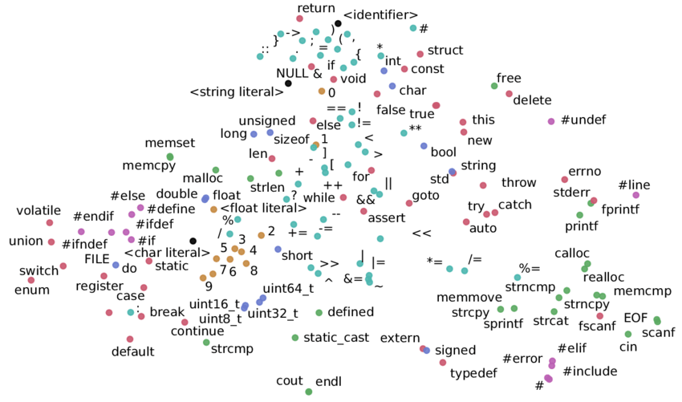
Visualization Algorithms

